Slide 1

ITS30705 CHAPTER 2: PYTHON FUNDAMENTALS

Slide 2
CONTENT
Python
Download Python
Code Editor
Essentials of a Python program
Reading and Writing
Integer
String
Variable

Slide 3
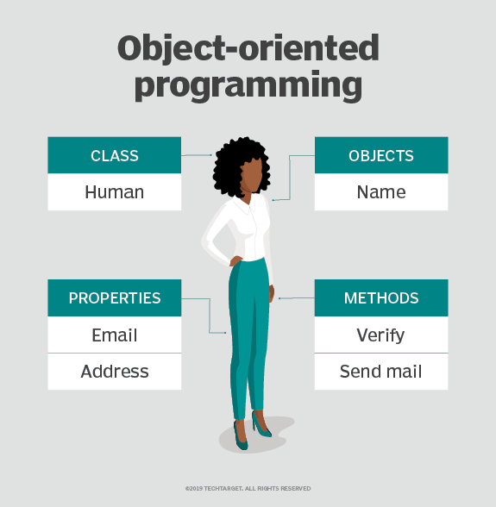
Python
Python is an Object-Oriented Programming (OOP) language.
OOP is a computer programming model that organizes software design around data, or objects, rather than functions and logic. An object can be defined as a data field that has unique attributes and behaviour.
Notes:
What is the structure of object-oriented programming?
The structure, or building blocks, of object-oriented programming include the following:
Classes are user-defined data types that act as the blueprint for individual objects, attributes and methods.
Objects are instances of a class created with specifically defined data. Objects can correspond to real-world objects or an abstract entity. When class is defined initially, the description is the only object that is defined.
Methods are functions that are defined inside a class that describe the behaviors of an object. Each method contained in class definitions starts with a reference to an instance object. Additionally, the subroutines contained in an object are called instance methods. Programmers use methods for reusability or keeping functionality encapsulated inside one object at a time.
Attributes are defined in the class template and represent the state of an object. Objects will have data stored in the attributes field. Class attributes belong to the class itself.

Slide 4
Python Uses
Game development
Machine learning
Scientific computation
Web application

Slide 5
WHY LEARN PYTHON?
Python is great for beginners because it has a simple syntax.
Large community of users.
Large collection of libraries and tools.
Huge variety of application.
One of the great benefits of python, is how easy it is to get started.

Slide 6
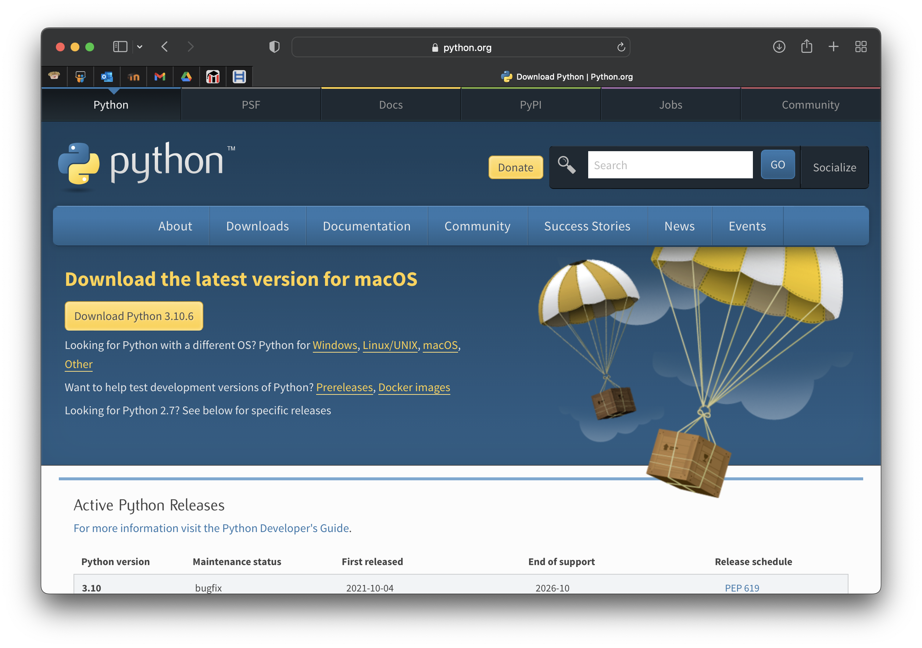
Download
Python.org

Slide 7
Python 3
Introduced in 2008
Large rewrite
Not backward compatible

Slide 8
CODE EDITOR
Python Shell
Visual Studio Code
PyCharm
Jupyter – Anaconda

Slide 9
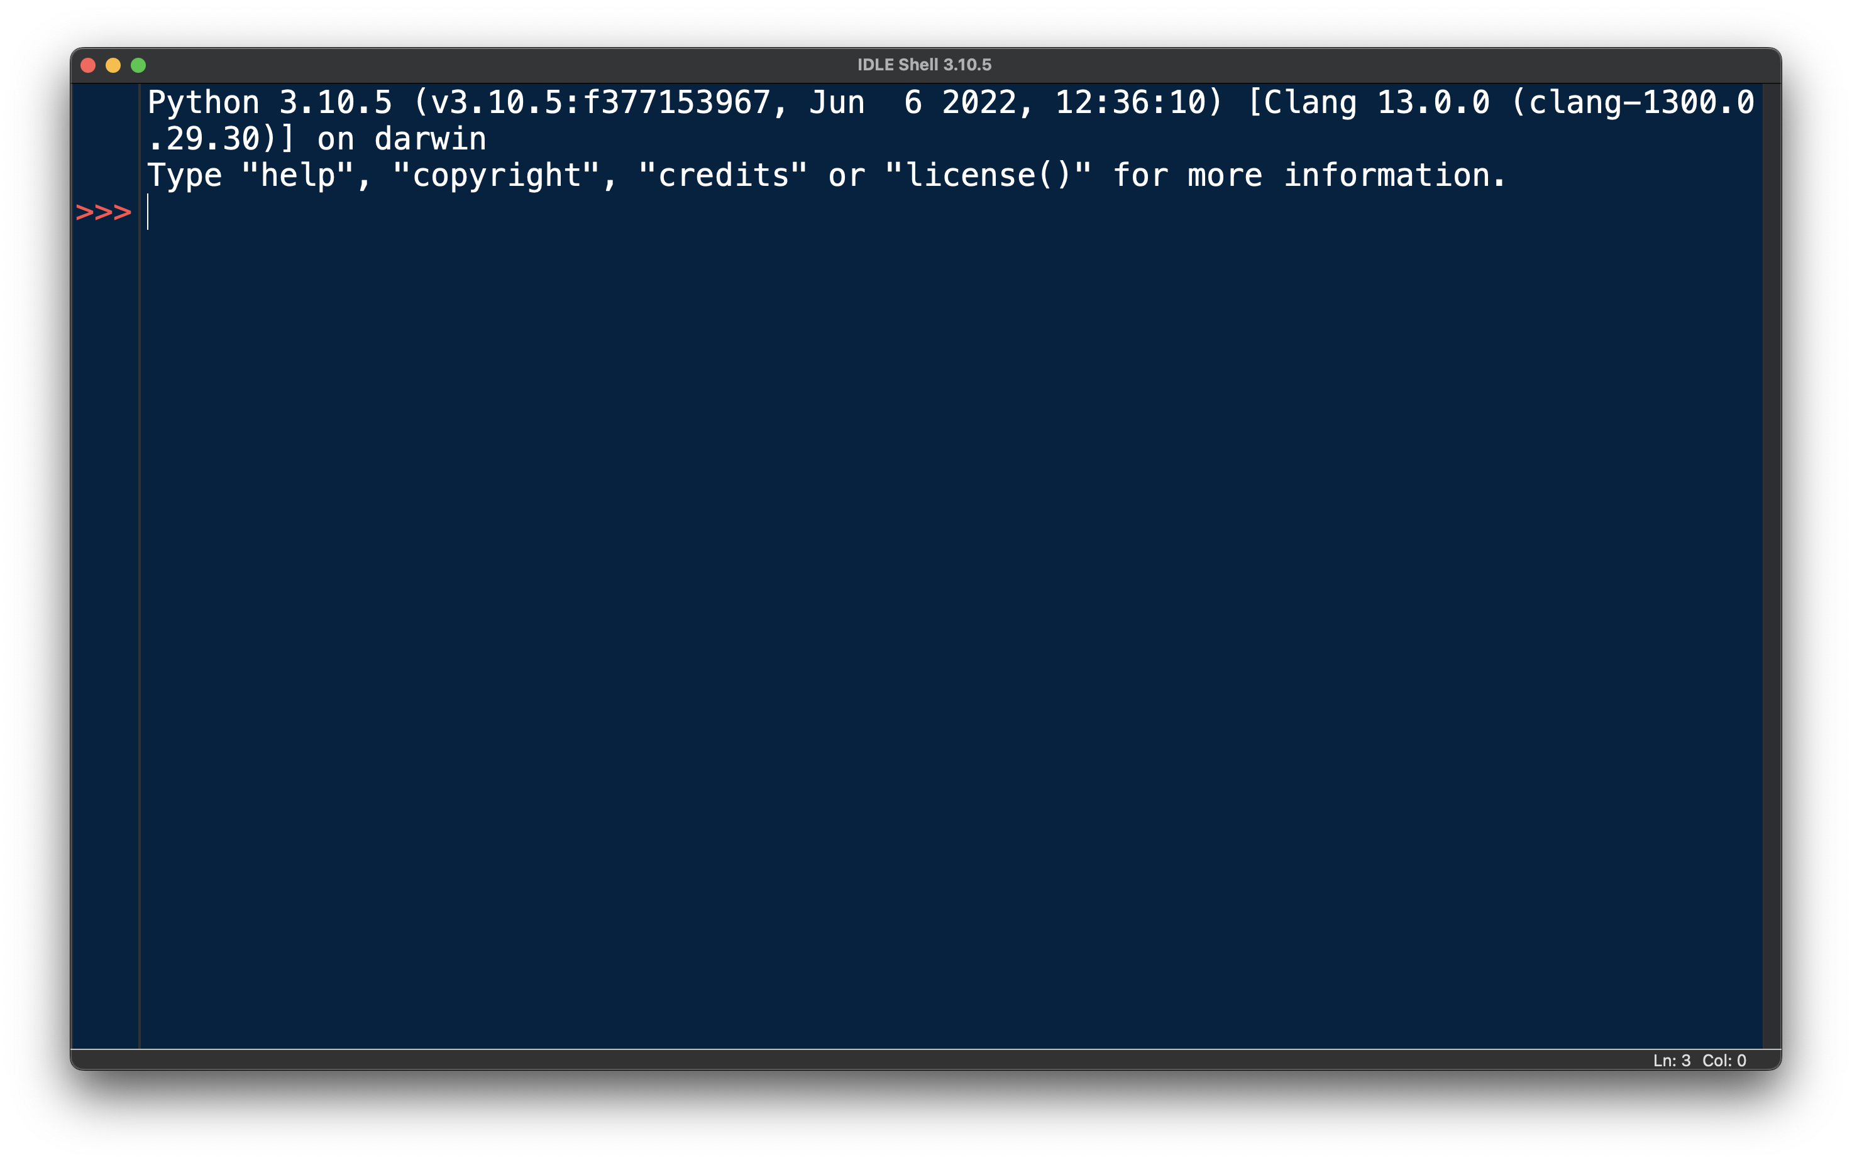
PYTHON SHELL

Slide 10
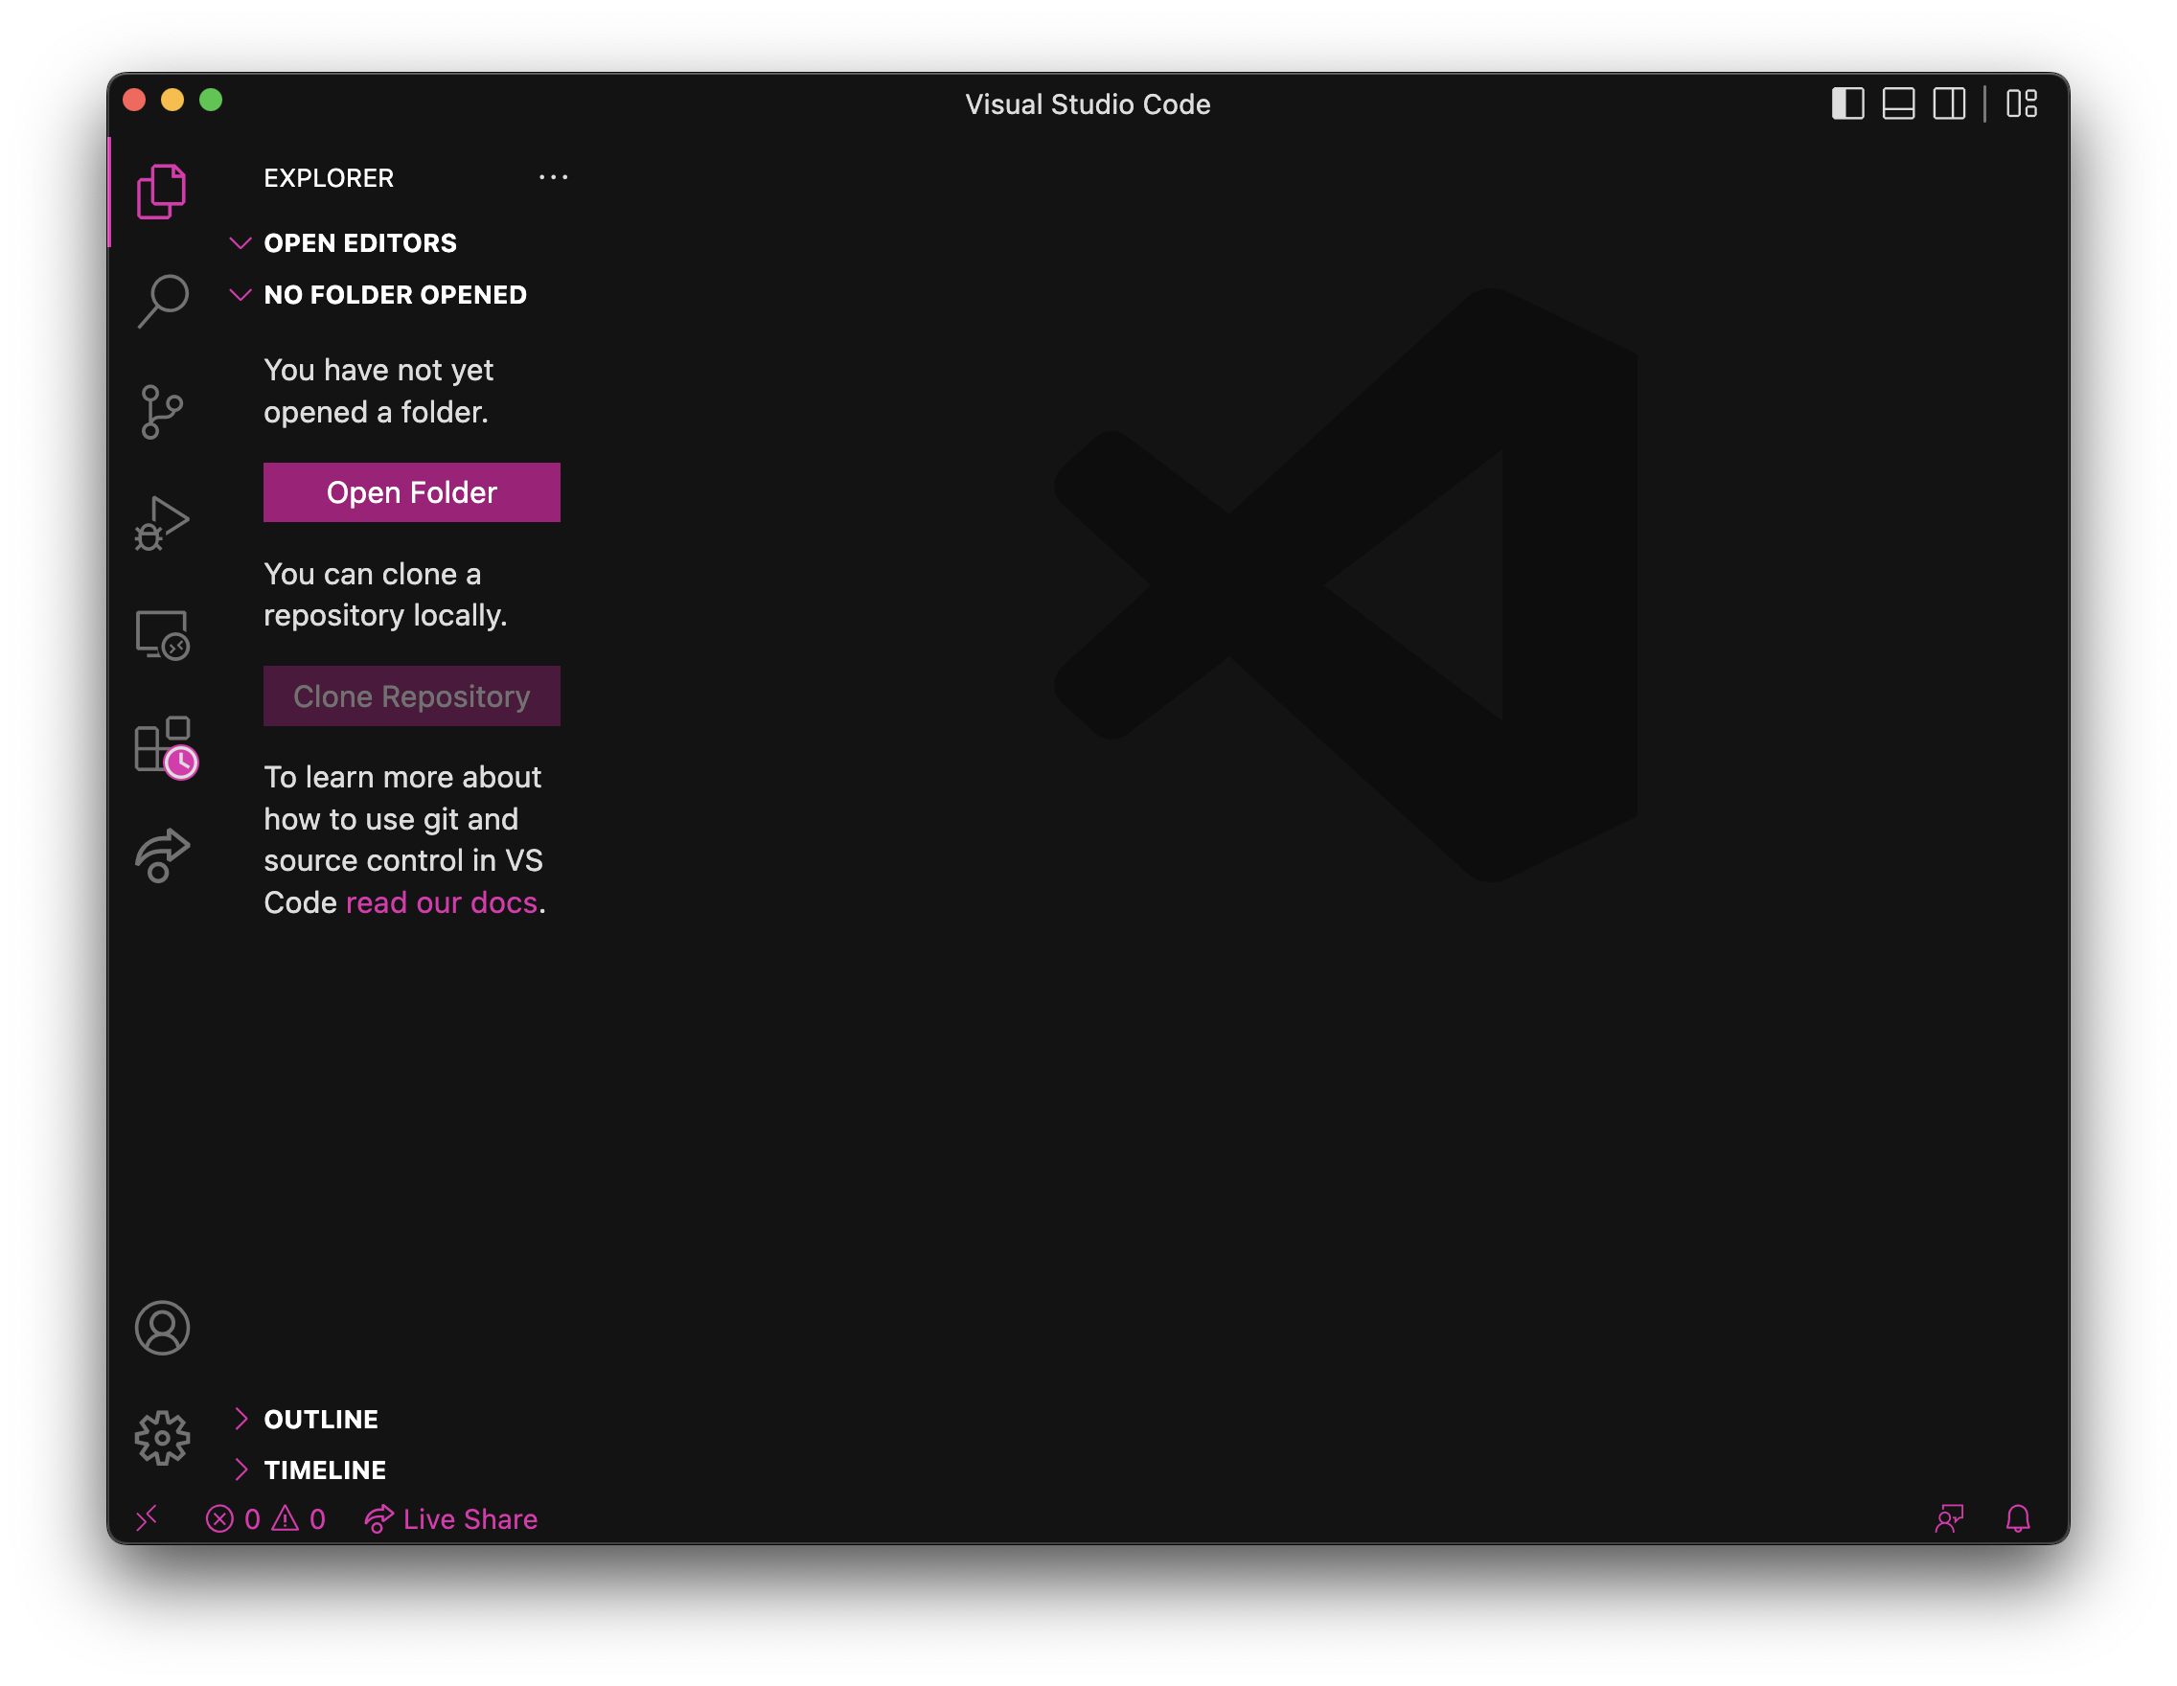
VISUAL STUDIO CODE

Slide 11
CODE EDITOR
Commands are executed immediately
Great for debugging and testing

Slide 12
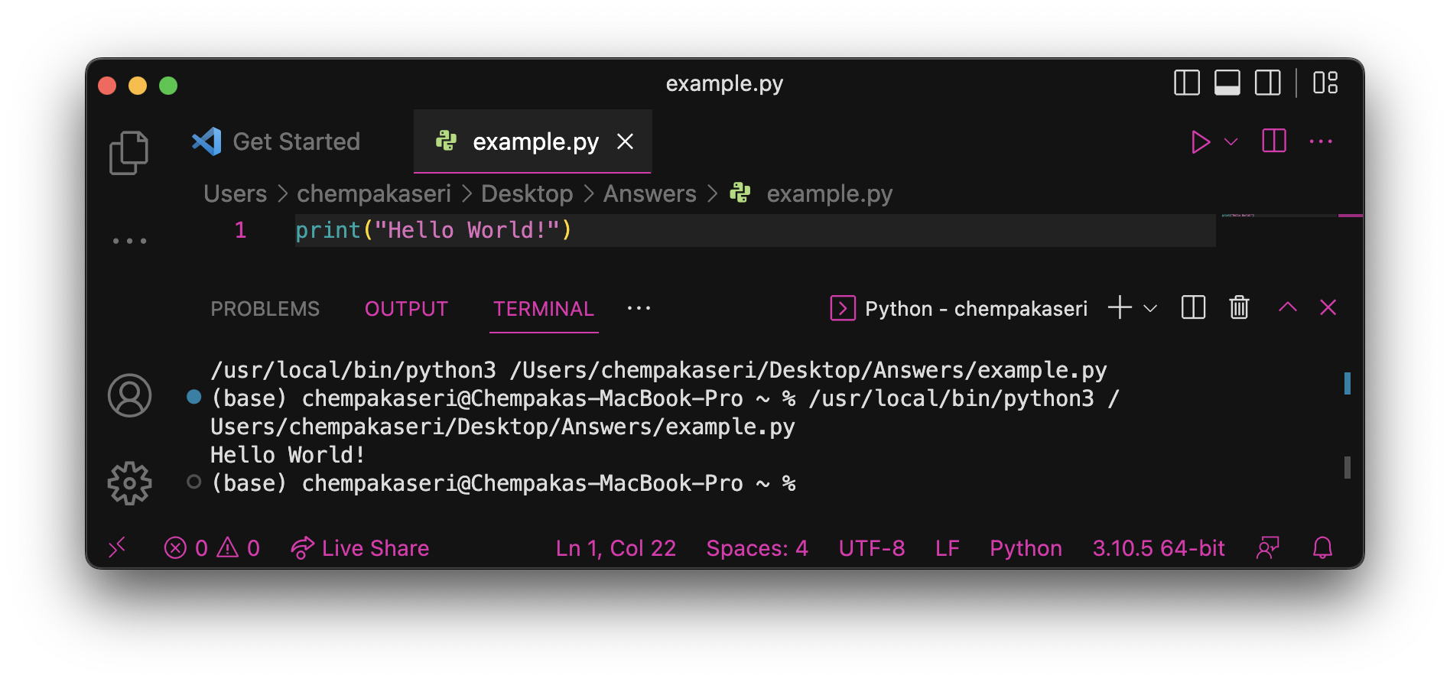
Essentials of a python program
Able to interpret and run correctly structures Python program.
For example, the following Python code is correctly structured and will run:
Other languages require a lot more structure in their simplest program, but in Python, this single line prints a short message is sufficient.

Slide 13
Identifier name
Many entities – variables are created that store values like numbers or strings, as well as functions and classes.
These entities is given names that be referred uniquely – identifiers.
Python has some rules when forming an identifier:
Only contain letters (uppercase and lowercase), numbers or the underscore character
No spaces
Don’t start with number

Slide 14
IDENTIFIER NAME
Few guidelines when naming variables to ensure that the code is easy to understand:
Be descriptive – a variable name should be describing the contents of the variable; a function name should indicate what the function does
Don’t use abbreviations unnecessarily – they may be ambiguous and more difficult to read.

Slide 15
Identifier name
Here are a few examples of identifiers:
Syntax Error | Bad Practice | Good Practice
Person Record | PRcrd | PersonRecord
DEFAULT-HEIGHT | Default_Ht | DEFAULT_HEIGHT
class | Class | AlgebraCourse
2totalweight | num2 | total_height

Slide 16
keyword
An identifier that you cannot use because it already has a reserved meaning in Python
and del from not while
as elif global or with
assert else if pass yield
break except import print
class exec in raise
continue finally is return
def for lambda try

Slide 17
Flow of control
In Python, statements are written as lists
The computer starts off by following the first instruction, then follow the next statements. The program only stops to executes after the last instructions is completed.
Flow of control is referred to the order in which the computer executes instructions.

Slide 18
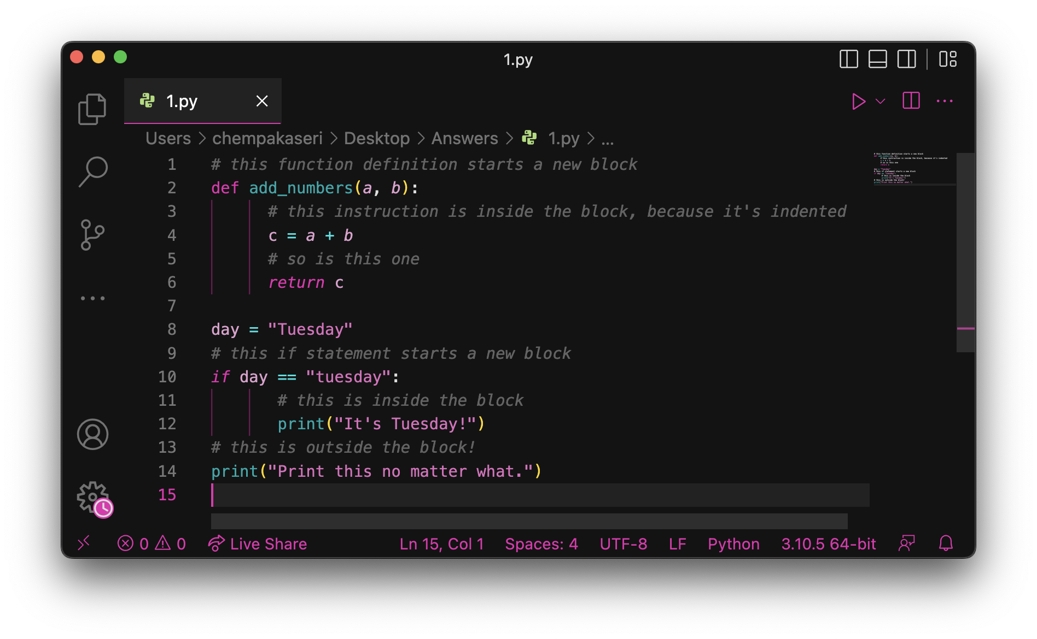
Indentation
Python uses indentation only to delimit blocks, so indent is a must.

Slide 19
COMMENT
Comment is used to help other programmers understand the program
Comments are not executed when the application start.
Syntax:

Slide 20
Reading and writing
Display text on the screen either to give information or to ask for information.
For example, tell the user what the program does:
Or ask the user for a number:
Welcome to John’s Calculating Machine
Enter the first number:

Slide 21
Reading and writing
To output information is to display a string using built-in print function. A string literal is text enclosed in quotes.
Use either single quotes (‘) or double quotes (“), but it need to match.
These are examples of string literals:
We can tell the computer to print “Hello!” with the following instruction:
print function takes in a string as an argument. It print the string and prints a newline characters at the end. Therefore, the console’s cursor appears on a new line after print something.
“Welcome to John’s Calculating Machine”
‘Enter the first number:’
print(“Hello!”)

Slide 22

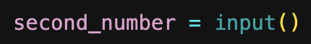
Reading and writing
To query the user for information, we use the input function.
Note that:
Unlike print function, the input function does not print a newline automatically – the text will be entered directly after the prompt.
The function always return a string – convert to respective data types
The string prompt is optional – we can use the input function without a parameter:

Slide 23
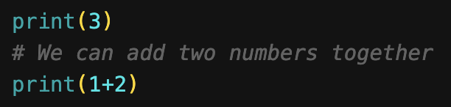
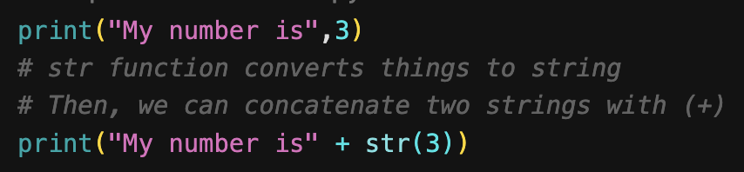
integer
An integer (int type) is a whole number such as 1, 5, 300, -34, or 190000.
Python can display an integer with the print function if it is the only argument.
Strings cannot combine with integer directly, because Python is strongly typed. So, there are several ways to display string and integer together.

Slide 24
Integer operations
Operation | Symbol | Example | Result
Addition | + | 28 + 10 | 38
Subtraction | - | 28 - 10 | 10
Multiplication | * | 28 * 10 | 280
Division | / | 28 / 10 | 2.8
Modulus (Remainder) | % | 28 % 10 | 8
Exponent (Power) | ** | 28 ** 10 | 296196766695424
Floor Division (Whole Number) | // | 28 // 10 | 2

Slide 25
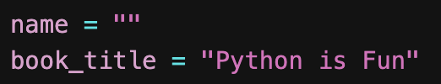
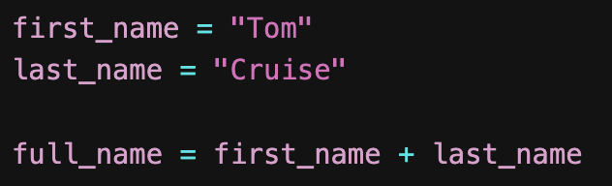
string
A string is a sequence of characters that are treated as a single value.
String class is used to store and process strings of characters.
Declaration and initialization
Concatenation
+ operator is used to connecting two strings

Slide 26
ESCAPE SEQUENCES
\n = Newline character. It cause the screen’s output cursor to move to the beginning of the next line
\t = Horizontal tab character
\\ = display the backslash character
\” = display a double quote character

Slide 27
VARIABLE
A variable is a storage location in the memory that has a type, name, and contents.
A variable must be declared, specifying the variable’s name and the type of information that will be held in it.
In Python, variable may contain letters, digits (0-9), and the underscore (_) characters.
However, variable cannot begin with a digit, cannot contain spaces, and cannot be reserved words.

Slide 28
VARIABLE – Define
To define a new variable, simply assign a value to a label.
For example, create a variable count that contains an integer value of 0.
In keeping with good programming style, we should make use of meaningful identifier names for variables.
count = 0

Slide 29
VARIABLE
A meaningful identifier will make the program easy to understand.
Python has a basic types for characters, integers, and floating-point number.
Python Data Type
Number
Dictionary
Sequence
Boolean
Set
Integer
Float
String
List
Tuple

Slide 30
Variable
Name | Type | Description | Example
Integers | int | Whole numbers | 3, 300, -8
Floating Point | float | Numbers with a decimal point | 2.3, 4.98, -9.19
Strings | str | Ordered sequence of characters | “hello”, “Sammy”, “200”
Lists | list | Ordered sequence of objects | [10.0, 78.3,200.3]
Tuples | tup | Ordered immutable sequence of objects | [10, “hello”,200.3]
Dictionaries | dict | Unordered Key:Value pairs | {“student_name”:“Maya”, “student_id”:“0367801”}
Sets | set | Unordered collection of unique objects | (“butter”,“apple”,34)
Booleans | bool | Logical value indicating | (True or False)

Slide 31
EXERCISE
Identify the data type for each variable
juice = [‘Apple’, ‘Orange’, ‘Pineapple’, ‘Mango’]
comment = 5.78
premier = “Better obserbent that is made in Malaysia”
books = {“title”:”A Desirable Residence”,”author”:”Lang Leav, Randal Munroe”}
likes = 250
marks = [78, 45, 90, 100, 87, 56]
list
float
string
dictionary
string
list

Slide 32
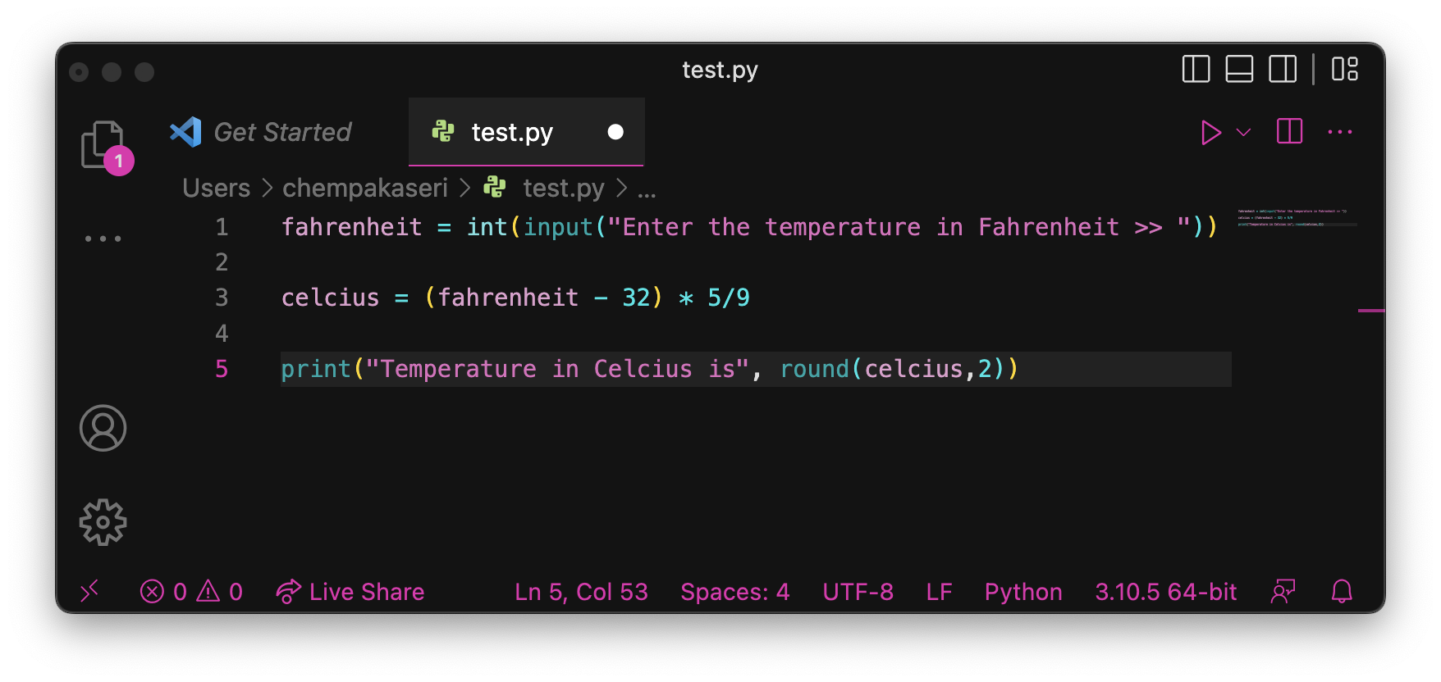
Reading and writing – EXERCISE
Pseudocode
INPUT Fahrenheit
Celsius = (Fahrenheit – 32) * 5/9
OUTPUT Celsius

Slide 33
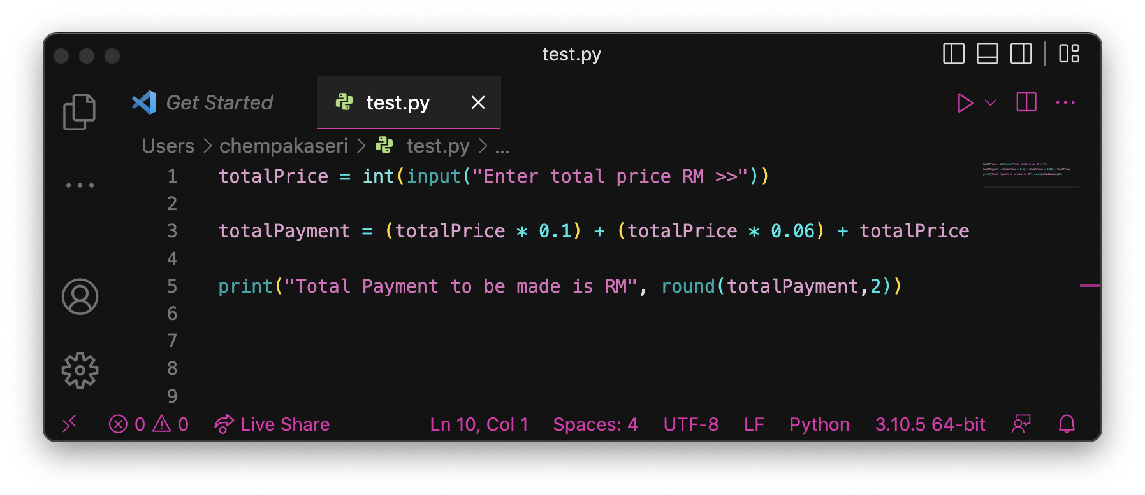
Reading and writing – EXERCISE
Pseudocode
INPUT TotalPrice
TotalPayment = TotalPrice + (TotalPrice * 0.1) + (TotalPrice * 0.06)
OUTPUT TotalPayment

